Slide 1
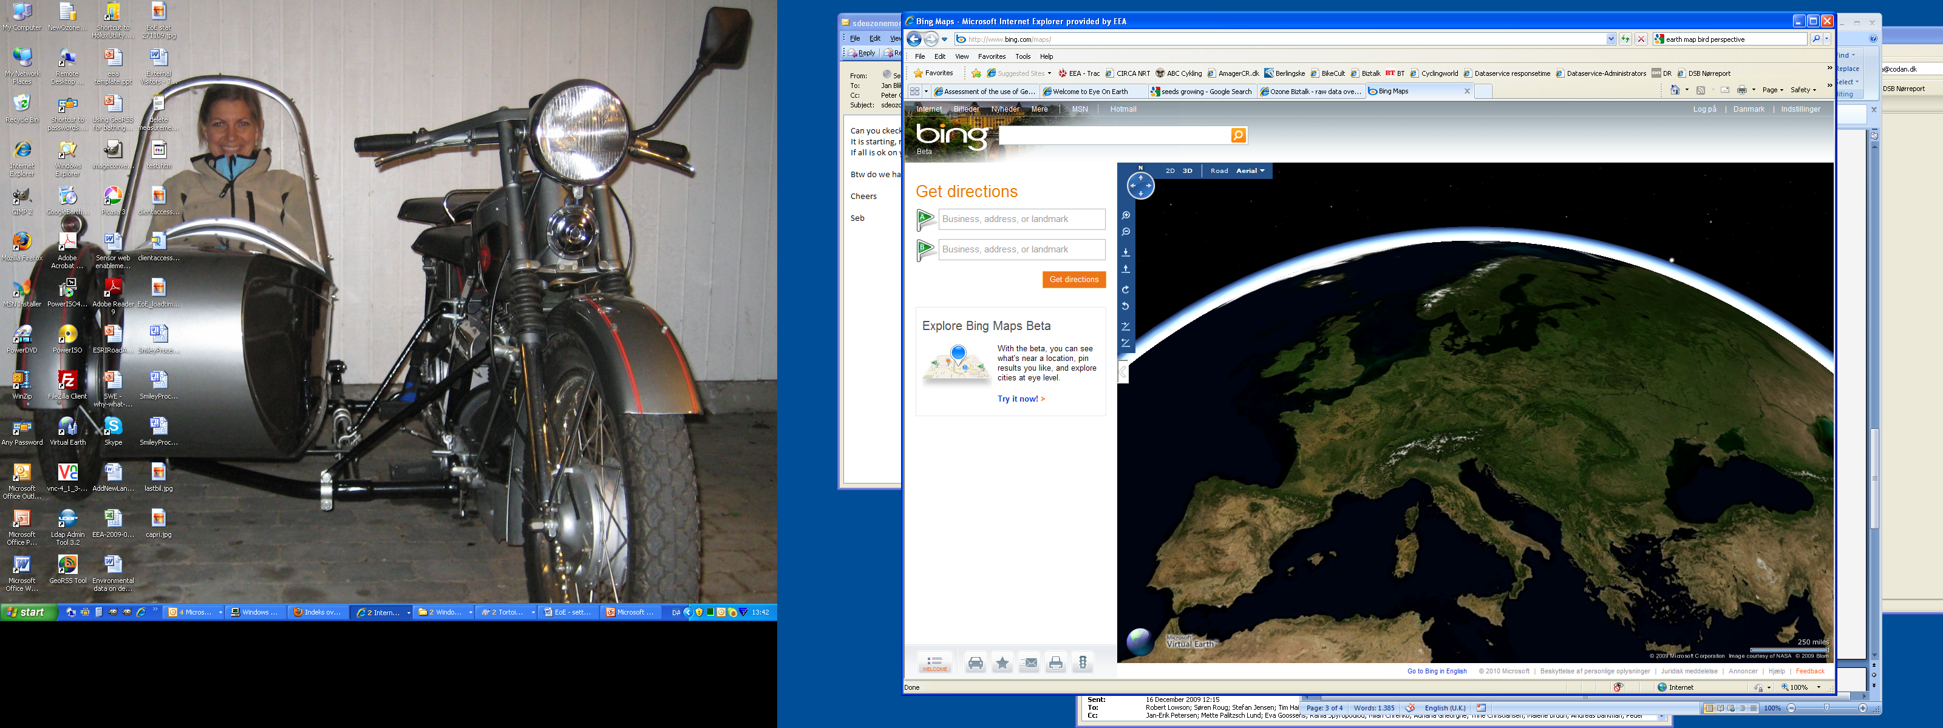
SWE implementation

Slide 2

SWE implementation
- growing seeds – Year 1

Slide 3

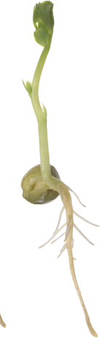
SWE implementation
- growing seeds – Year 3

Slide 4
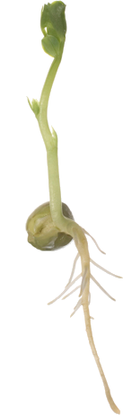
SWE implementation
- growing seeds – Year ?

